Slide 1

TrafficTelligence: Advanced Traffic Volume Estimation with Machine Learning
PRESENTED BY
Team Members
Team ID: LTVIP2025TMID40374
Team Size : 4
Team Leader : Saritha Kumari Oggu
Team member : Divya Kovvali
Team member : Velpula Deepika
Team member : Kolluru Teja Mahitha

Slide 2
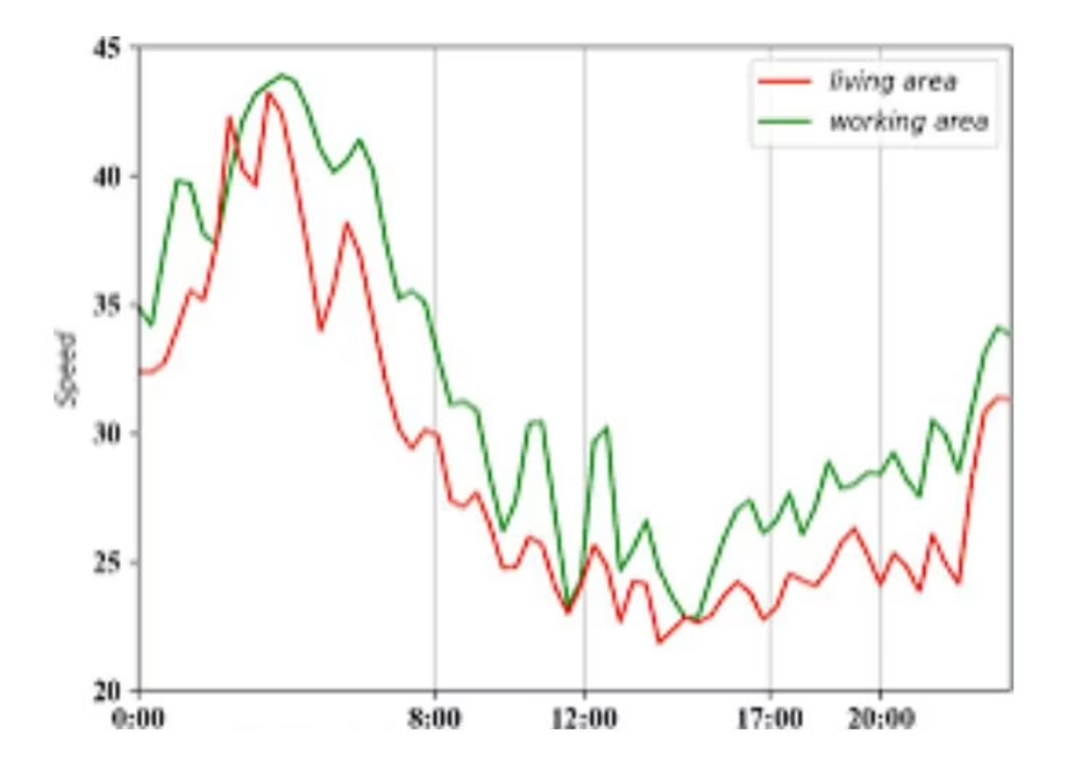
Project Overview: Revolutionizing Traffic Management
TrafficTelligence is an advanced system that uses machine learning algorithms to estimate and predict traffic volume with precision. By analyzing historical traffic data, weather patterns, events, and other relevant factors, TrafficTelligence provides accurate forecasts and insights to enhance traffic management, urban planning, and commuter experiences.
Dynamic Traffic Management
Real-time estimations for adaptive traffic control and optimal lane configurations.
Urban Development Planning
Forecasts to design efficient road networks and public transit systems.
Commuter Guidance and Navigation
Accurate predictions for intelligent route planning and improved travel times.

Slide 3
Setup & Installation Guide
Requirements
Download Dataset
Python 3.7+
Place your dataset file in the project folder as traffic_data.csv.
pip
If from Kaggle:
Jupyter Notebook or any IDE (VS Code, Colab, etc.)
Folder Structure
kaggle datasets download -d your_dataset_name
TrafficTelligence/├── traffic_data.csv # Your dataset├── traffic_model.ipynb # Jupyter Notebook (main code)├── requirements.txt # List of Python packages├── README.md # Project description└── traffic_app.py # Optional Python script
Run the Model
Jupyter:
jupyter notebook traffic_model.ipynb
Install Python Libraries
pip install -r requirements.txt# Or manually:pip install pandas numpy matplotlib scikit-learn
Python Script:
python traffic_app.py
Check Output
Verify predictions, graphs, and accuracy/R² score.
Optional: GitHub Setup
git initgit add .git commit -m "Initial commit"git remote add origin [Your GitHub Repo URL]git push -u origin main

Slide 4




Ideation Phase: Addressing Traffic Congestion
The Problem
The Solution
Core Idea
Traditional methods fail to capture the dynamic nature of traffic flow, leading to inaccurate predictions and inefficient traffic management.
TrafficTelligence uses ML to provide accurate, real-time traffic volume estimations, optimizing traffic flow and mitigating congestion.
Analyze diverse data (historical, real-time sensor, weather) to predict traffic volume and identify congestion points proactively.

Slide 5





Requirement Analysis: Data-Driven Foundations
TrafficTelligence, an advanced traffic volume estimation system leveraging machine learning, requires robust requirement analysis for effective implementation. This focuses on defining functional/non-functional requirements, identifying data sources and their quality, and selecting appropriate machine learning models.
Historical Traffic Data
Archived volume, speed, and occupancy from loop detectors, video cameras, radar.
Real-time Traffic Data
Live feeds from sensors, probe vehicles, and crowd-sourced navigation apps.
Weather Data
Information on temperature, precipitation, and visibility affecting traffic flow.
Event Data
Information on special events (concerts, sports) causing traffic disruptions.

Slide 6
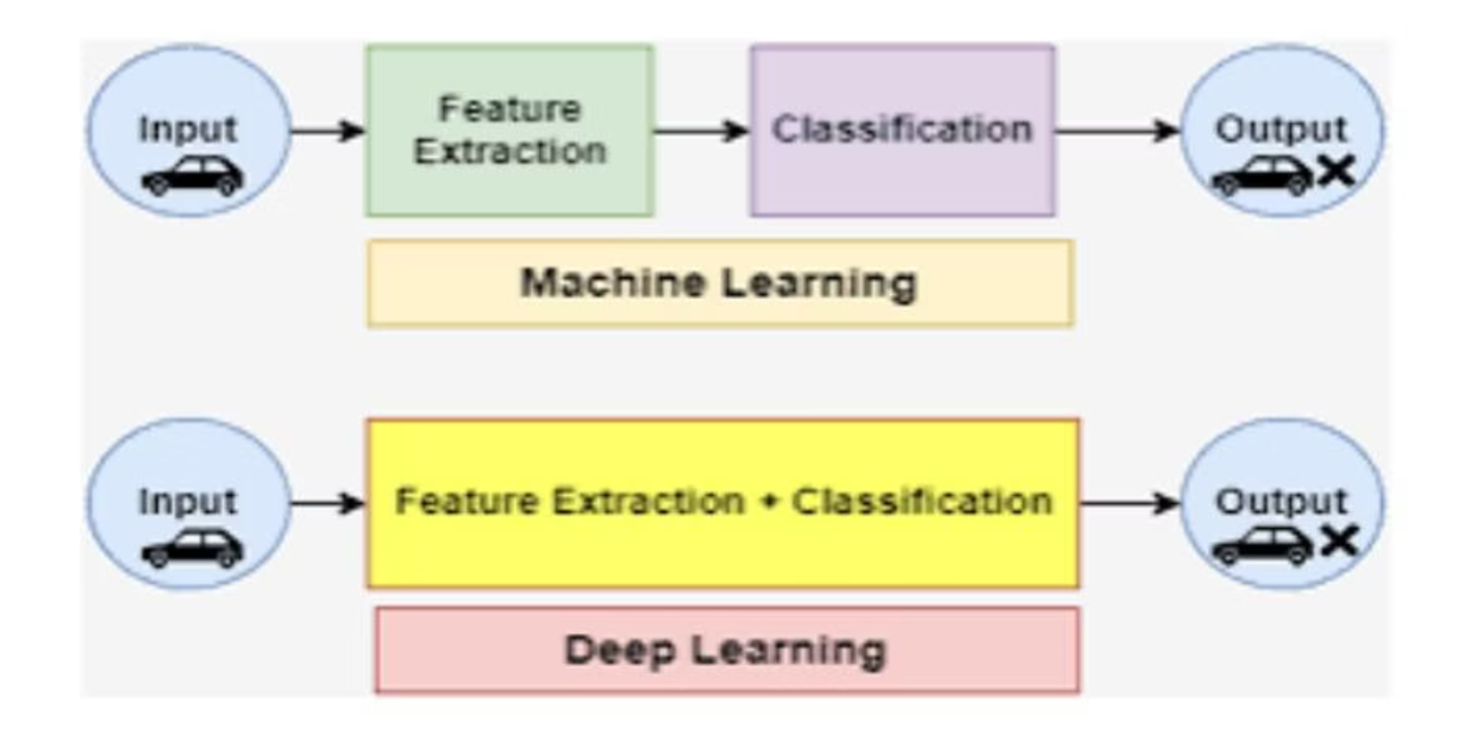
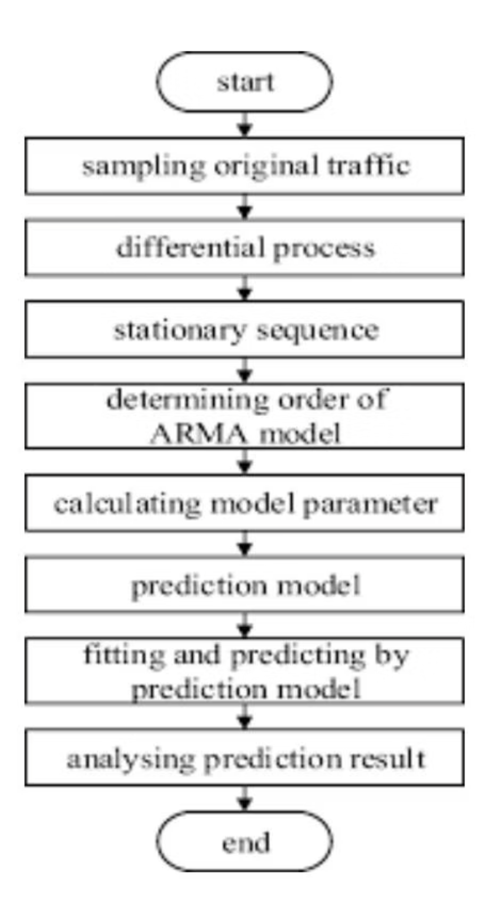
Running Application & Technical Stack
Code Structure & Libraries
TrafficTelligence utilizes Python libraries for data handling (pandas, numpy), ML modeling (scikit-learn), and visualization (matplotlib, seaborn).
import pandas as pdfrom sklearn.model_selection import train_test_splitfrom sklearn.linear_model import LinearRegressionfrom sklearn.metrics import mean_absolute_error, mean_squared_error, r2_scoreimport matplotlib.pyplot as pltdf = pd.read_csv('traffic_data.csv')df = df.dropna()X = df[['hour', 'temperature', 'day']]y = df['traffic_volume']X_train, X_test, y_train, y_test = train_test_split(X, y, test_size=0.2, random_state=42)model = LinearRegression()model.fit(X_train, y_train)y_pred = model.predict(X_test)mae = mean_absolute_error(y_test, y_pred)mse = mean_squared_error(y_test, y_pred)r2 = r2_score(y_test, y_pred)print(f"MAE: {mae:.2f}")print(f"MSE: {mse:.2f}")print(f"R^2 Score: {r2:.2f}")
Solution Overview
TrafficTelligence is an advanced traffic volume estimation system that uses machine learning to predict traffic patterns and optimize travel routes. It provides commuters with accurate predictions, reducing congestion through diverse data sources and sophisticated ML models.

Slide 7
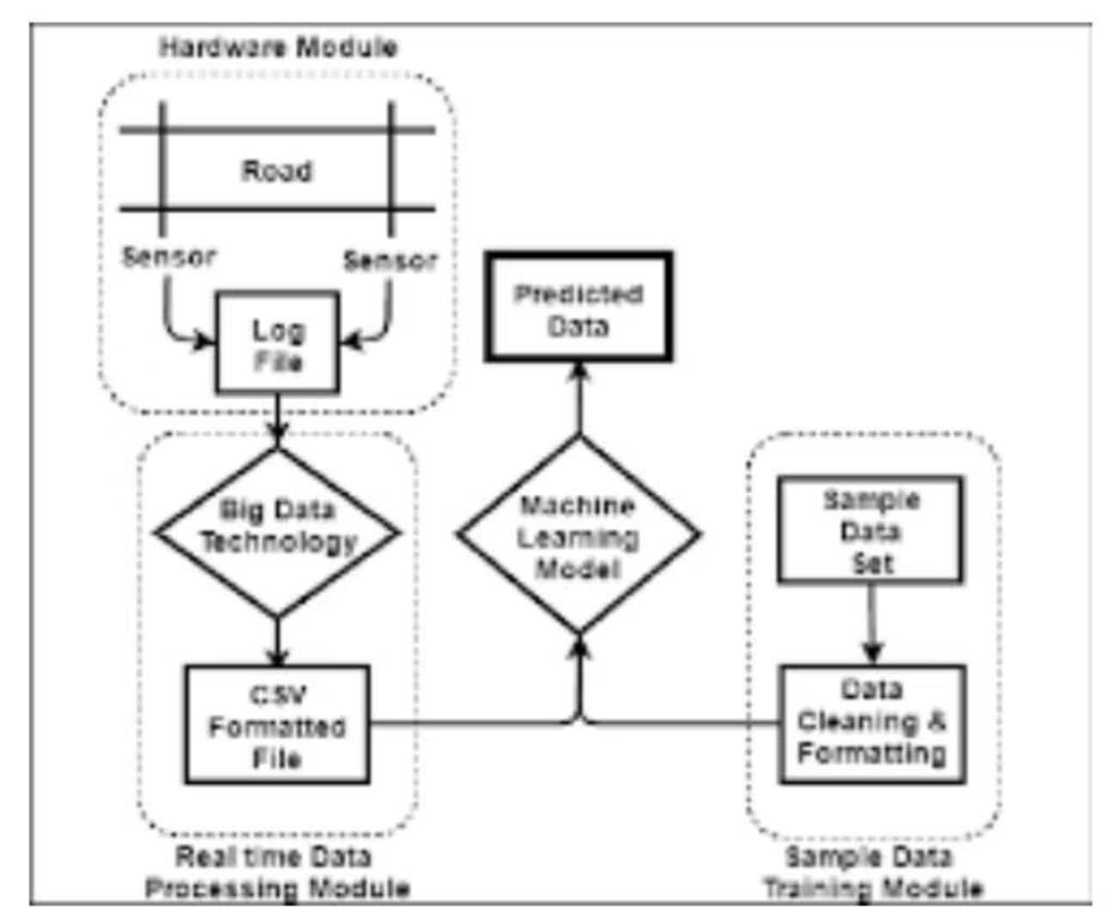
Project Design: Solving the Congestion Problem
TrafficTelligence aims to improve traffic management by providing accurate predictions of traffic volume, enabling better route planning and congestion control. It leverages diverse data sources and sophisticated algorithms to offer commuters optimal travel routes and timings.
How TrafficTelligence Achieves This:
Data Integration & Preprocessing: Diverse sources, feature engineering, data cleaning.
Advanced Machine Learning Models: Supervised/unsupervised learning, model selection, hyperparameter tuning.
Real-time Predictions & User Guidance: Accurate predictions, optimal route planning, dynamic adjustments.
ResearchGate states that machine learning can effectively forecast traffic flow dynamics by integrating historical and real-time data.
Benefits: Time savings, reduced congestion, improved safety.

Slide 8
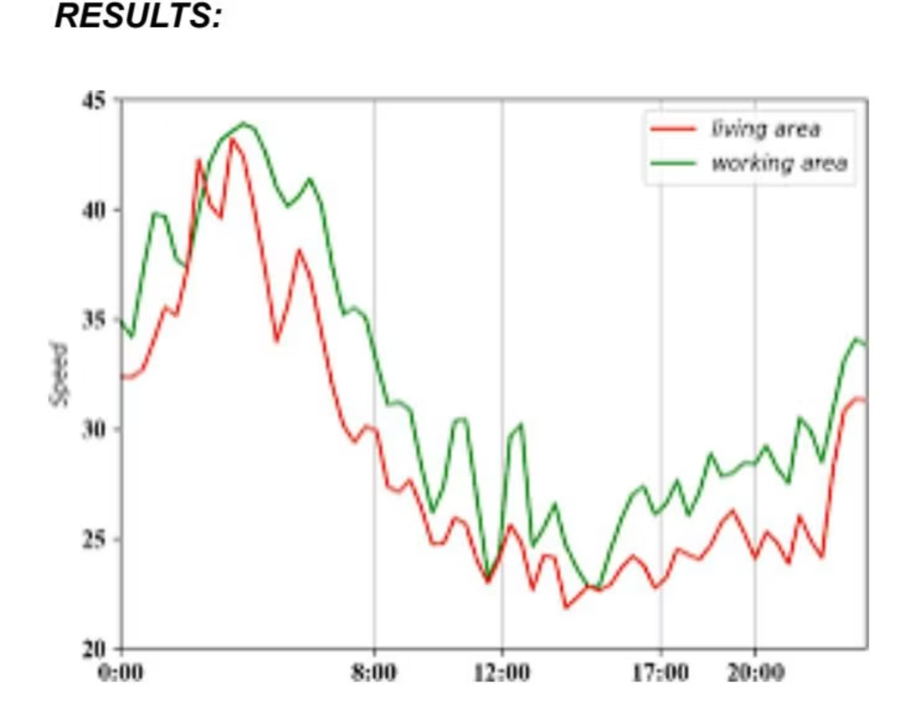
Project Planning, Scheduling & Testing
Project Goals
Testing & Validation
Accurate Traffic Volume Estimation
Dataset Splitting: 80% training, 20% testing for generalization.
Route Optimization
Evaluation Metrics: MAE, RMSE, R² Score (e.g., R² = 0.89).
Dynamic Traffic Management
Real-Time Scenarios: Simulated live data comparison.
Scalability & Real-world Applicability
Cross-Validation: K-Fold (K=5) to prevent overfitting.
Project Phases
Edge Case Testing: Handles low traffic, spikes, and weather variations.
Visual Testing: Graphs of predicted vs. actual volumes, error distribution.
Data Collection & Preprocessing
Model Development
Route Optimization Integration
Real-time System Development
Deployment & Monitoring
Potential Benefits
Reduced Congestion
Improved Travel Time
Enhanced Safety
Reduced Environmental Impact
Better Traffic Management

Slide 9
Advantages & Disadvantages
Pros
Cons
High Accuracy & Precision: Machine learning models can identify complex patterns, leading to highly accurate traffic volume estimations.
Heavy Data Requirements: ML models require vast amounts of historical and real-time data for training and accuracy.
Computational Expense: Training and running complex models can be resource-intensive, requiring powerful hardware.
Real-Time & Scalable Processing: Systems can handle large volumes of data and provide real-time updates, adapting to changing traffic conditions.
Complexity & Interpretability Issues: Black-box nature of some ML models can make understanding their decisions difficult.
Pattern Detection & Adaptability: ML algorithms can detect subtle trends and anomalies, adapting to new data over time.
Overfitting & Generalization Risks: Models might perform well on training data but fail to generalize to new, unseen traffic conditions.
Handles Missing Data Well: Robust models can interpolate missing data points, ensuring continuous operation.
Integration & Maintenance Burden: Integrating with existing systems and continuous maintenance can be challenging.
Supports Infrastructure Planning: Accurate forecasts aid urban planners in designing efficient future road networks.
Privacy & Ethical Concerns: Use of surveillance data raises privacy concerns that need careful management.

Slide 10

Conclusion & Future Scope
Achieved Outcomes
Future Enhancements
Developed an effective ML model for traffic volume estimation.
Real-Time Monitoring: Integrate live sensor/video data for dynamic predictions.
Preprocessed and analyzed real-world traffic data for patterns.
Multi-City Deployment: Train models on diverse city datasets for robustness.
Achieved high prediction accuracy (R² score, low MAE/RMSE).
Weather & Event Integration: Incorporate external factors for accuracy.
Demonstrated practical use through real-time scenario testing.
User-Friendly Interface: Develop mobile app/dashboard for authorities.
Identified advantages and limitations for realistic project assessment.
IoT Integration: Connect with smart traffic lights for intelligent control.
TrafficTelligence significantly enhances urban traffic monitoring, reduces manual effort, and supports smart city development.
Anomaly Detection: Module to identify unusual traffic spikes.
Data Privacy & Security: Implement robust encryption and handling practices.
Edge Computing: Deploy models on local devices to reduce server load.
Public API: Provide traffic predictions for navigation apps.
Green Signal Optimization: Dynamically adjust traffic light timings.

